Slide 1

Customer Shopping Behavior Analysis
Uncovering insights from transactional data to guide strategic business decisions.

Slide 2

Project Overview
1
2
Data Source
Key Goal
3,900 purchases across product categories.
Uncover spending patterns, segments, preferences, and subscription behavior.
3
Strategic Impact
Guide business decisions for optimization.

Slide 3

Dataset Summary
Key Features
Data Snapshot
Customer demographics (Age, Gender, Location, Subscription)
Rows: 3,900
Columns: 18
Purchase details (Item, Category, Amount, Season, Size, Color)
Missing Data: 37 values in Review Rating
Shopping behavior (Discount, Promo, Previous Purchases, Frequency, Review, Shipping)

Slide 4
Exploratory Data Analysis (Python)
01
02
03
Data Loading & Exploration
Missing Data Handling
Column Standardization
Imported with pandas, checked structure and summary statistics.
Imputed Review Rating using median per category.
Renamed to snake_case for readability.
04
05
Feature Engineering
Database Integration
Created age_group and purchase_frequency_days.
Loaded cleaned data into PostgreSQL for SQL analysis.

Slide 5

Data Analysis (SQL) - Key Insights
Revenue by Gender
Top 5 Products by Rating
Male: $157,890 | Female: $75,191
Gloves, Sandals, Boots, Hat, Skirt.
Shipping Type Comparison
Express: $60.48 avg. | Standard: $58.46 avg.

Slide 6
SQL Analysis - Subscription & Discounts
Subscribers vs. Non-Subscribers
Discount-Dependent Products
Hat: 50% discounted purchases
Yes
1053
$59.49
$62,645
Sneakers: 49.66% discounted purchases
No
2847
$59.87
$170,436
Coat: 49.07% discounted purchases
Sweater: 48.17% discounted purchases
Pants: 47.37% discounted purchases

Slide 7


SQL Analysis - Customer Segmentation
Loyal
New
3116 Customers
83 Customers
Returning
701 Customers

Slide 8
SQL Analysis - Product & Age Insights
Top Products per Category
Revenue by Age Group
Accessories: Jewelry, Sunglasses, Belt
Young Adult
$62,143
Clothing: Blouse, Pants, Shirt
Footwear: Sandals, Shoes, Sneakers
Middle-aged
$59,197
Outerwear: Jacket, Coat
Adult
$55,978
Senior
$55,763

Slide 9
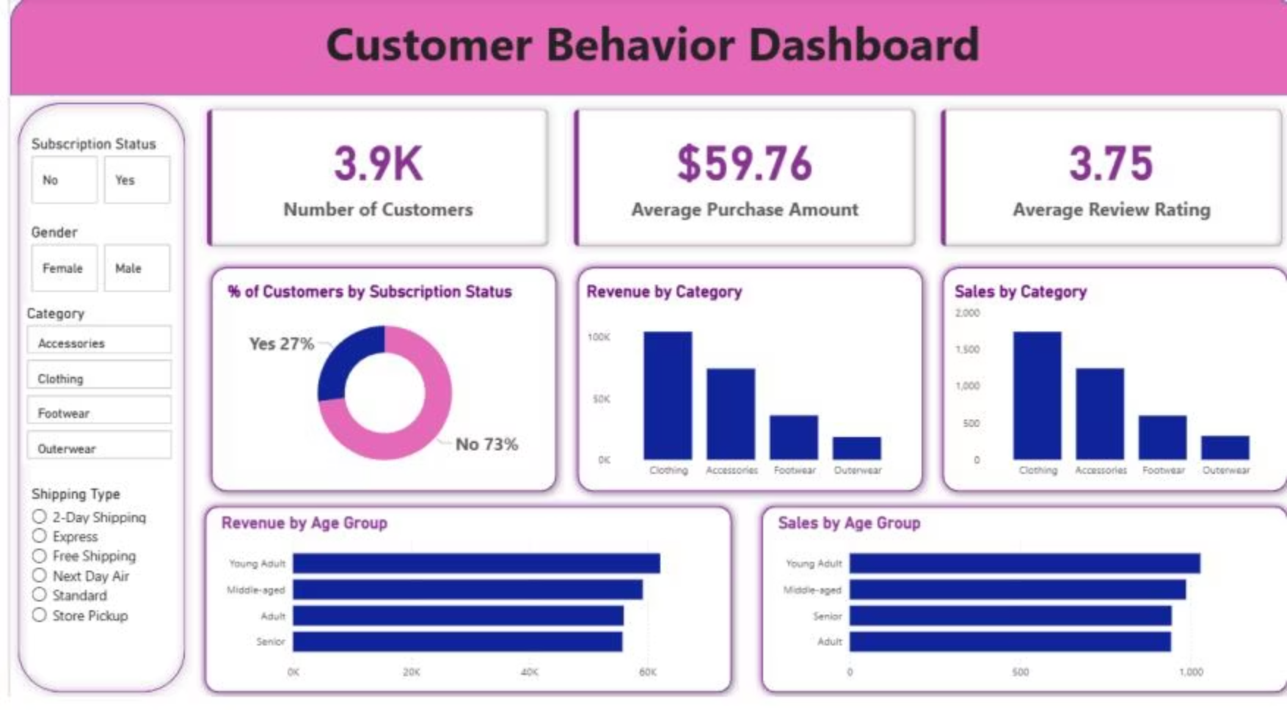



Power BI Dashboard
Interactive visualization of key metrics and trends.
27%
59.76
3.75
Subscribed Customers
Avg. Purchase Amount
Avg. Review Rating

Slide 10
Business Recommendations
Boost Subscriptions
Promote exclusive benefits.
Customer Loyalty
Reward repeat buyers.
Review Discount Policy
Balance sales with margins.
Product Positioning
Highlight top-rated items.
Targeted Marketing
Focus on high-revenue groups.

